Slide 1
Unit -1
Puppet Basic

Slide 2
Unit -1 Syllabus
Configuration Management System: Configuration Management,
Pull, Push,
Introduction to Puppet: Puppet, Why Puppet, Components of Puppet, Puppet Architecture: Puppet Master: Manifest, Template, Files, Certificate Authority, Puppet Clients: Agent, Facter, Installation of Puppet, Puppet Development in Isolation.

Slide 3
Introduction to Puppet
Puppet is a open-source configuration management tool that uses a pull-based model to automate the provisioning, configuration, and management of servers and applications across your infrastructure.
It enables infrastructure as code (IaC) by letting you define desired system states using a declarative language.
It follows the Infrastructure as Code (IaC) principle, enabling automation and consistency across your servers.
You can also use Puppet as a deployment tool as it can automatically deploy software on the system.
Puppet implements infrastructure as code, which means you can test the environment and ensure that it is deployed accurately.

Slide 4
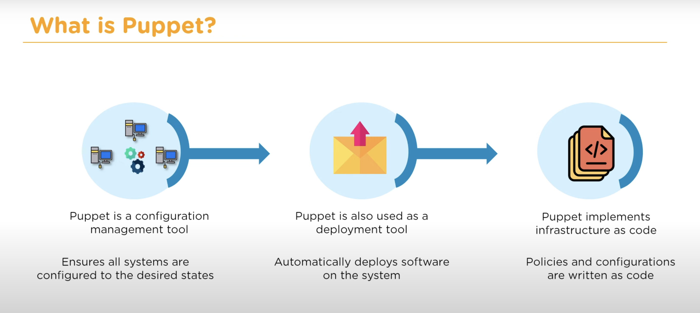

Slide 5
Puppet has two main parts :
Part | Description
Puppet Master (Server) | Central system that stores configuration (manifests)
Puppet Agent (Client) | Installed on every machine you want to configure

Slide 6
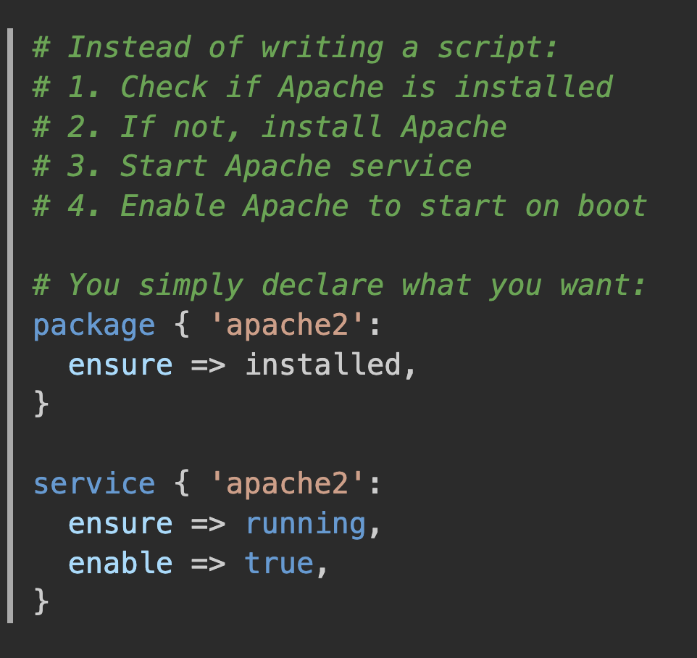
Why Choose Puppet?
1. Declarative Language
  Instead of writing scripts that say
  "how to do something,"
  you write manifests that describe
  "what you want."

Slide 7
2. Idempotency:
  Puppet ensures that applying the same configuration multiple times produces the same result without causing issues.
  Real-world example:
  First run: Installs Apache, starts service
  Second run: Checks Apache is installed and running, does nothing
  Third run: Still does nothing (system already in desired state.
3. Cross-Platform Support
  Works on Linux, Windows, macOS, and various Unix systems.

Slide 8
4. Large Community and Enterprise Support
  Open-source version available
  Enterprise version with additional features
  Large community contributions
  Extensive module library (Puppet Forge)

Slide 9
Key Use Cases
1. Server Configuration Management
  Web server configurations
  Database server setups
  Application deployments
2. Compliance Management
  Security hardening
  Regulatory compliance (SOX, PCI-DSS, HIPAA)
  Audit trail maintenance
3. Infrastructure as Code
  Version-controlled infrastructure
  Reproducible environments
  Environment promotion (dev → test → prod)
Notes:
SOX (Sarbanes–Oxley Act): Financial reporting controls for public companies.
PCI-DSS (Payment Card Industry Data Security Standard): Protects credit card information.
HIPAA (Health Insurance Portability and Accountability Act): Protects patients' medical records.

Slide 10
Components of Puppet
Puppet follows a client-server architecture (with agent/master model), but also supports standalone mode (puppet apply).
Its components can be grouped into core, data, and execution layers.
The various components of puppet are :
  Puppet Master (Server)
  Puppet Agent (Client)
  Manifests
  Modules
  Facter
  Catalog
Notes:
Component
Purpose
Example
Puppet MasterCentral server that stores configurations and generates catalogsSends instructions to all agents
Puppet AgentRuns on each managed machine and applies configurationsInstalls Nginx on a server
Manifest.pp file describing the desired stateInstall and start Nginx
ModuleOrganized collection of Puppet code for a specific tasknginx module, mysql module
FacterCollects system informationOS: Ubuntu, RAM: 8 GB, IP: 192.168.1.10
CatalogFinal set of instructions sent to an agentInstall Nginx, create user, enable firewall

Slide 11
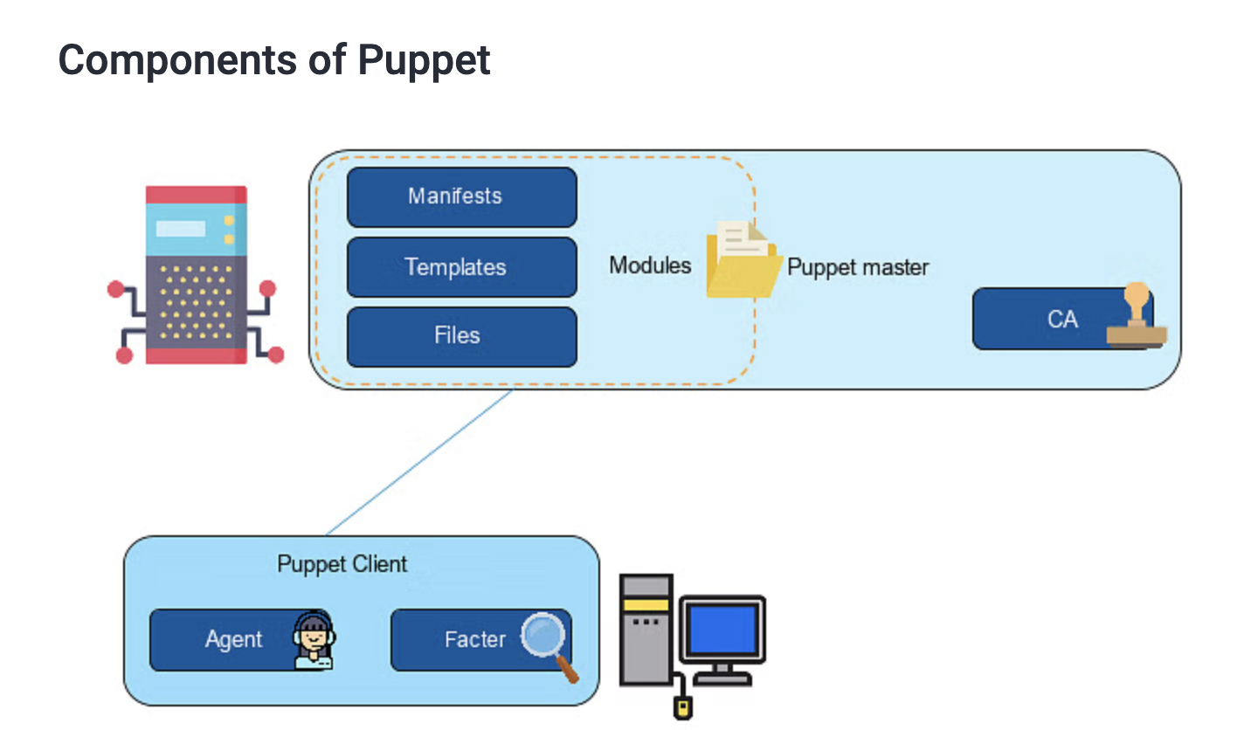

Slide 12
The Puppet environment can be broken down into the main server environment and the client environment.
In the main server environment, there is a Puppet master store which stores all configuration files.
  Manifests are the actual codes for configuring the clients
  Templates combine code and data to render a final document
  Files are the static content that can be downloaded by the clients
  Modules are a collection of manifests, templates, and files
  Certificate authority allows the master to sign the certificates sent by the client
The Puppet client is the machine that needs to be configured, consisting of Agent and Factor. The agent continuously interacts with the master server to ensure that the certificates are being updated appropriately. The factor collects the current state of the client that is used and communicates it back through the agent.

Slide 13
Puppet Master :
The central server that stores and serves configurations to client machines.
Key Functions:
  Stores manifests and modules
  Compiles catalogs for agents
  Manages certificates
  Serves files and templates

Slide 14
Puppet Agent (Client)
Software that runs on managed nodes and applies configurations.
Key Functions:
  Requests catalogs from Puppet Master
  Applies configurations to the local system
  Reports back to Puppet Master
  Gathers system facts

Slide 15
3. Manifests
  Text files written in Puppet's domain-specific language (DSL) that describe the desired state of system resources.
4. Modules
  Reusable collections of manifests, files, templates, and other resources organized in a specific directory structure.
5. Facter
  A system inventory tool that gathers facts about nodes (hardware, OS, network configuration, etc.).
6. Catalog
  A compiled document that describes the desired state of a particular node, created by the Puppet Master from manifests and sent to agents.

Slide 16
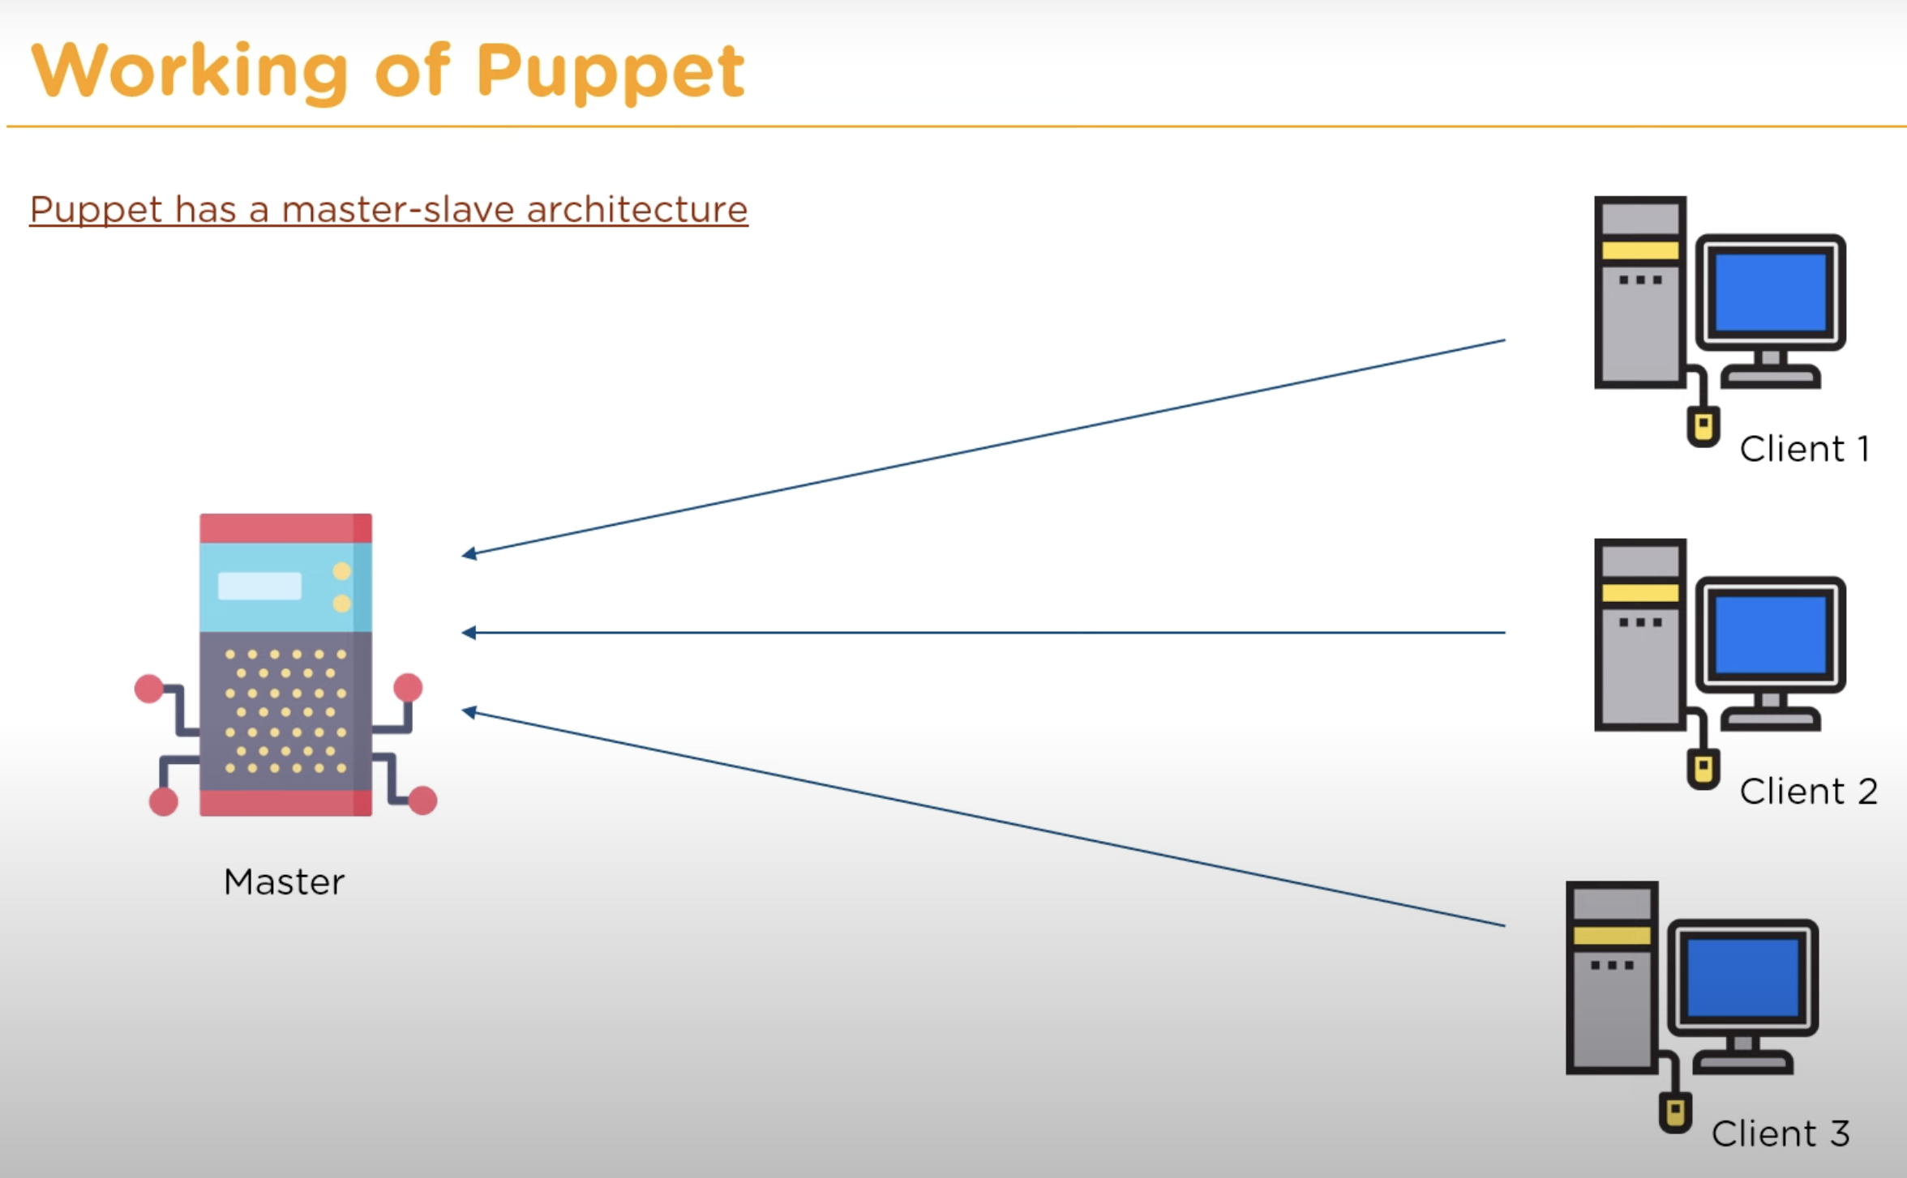

Slide 17
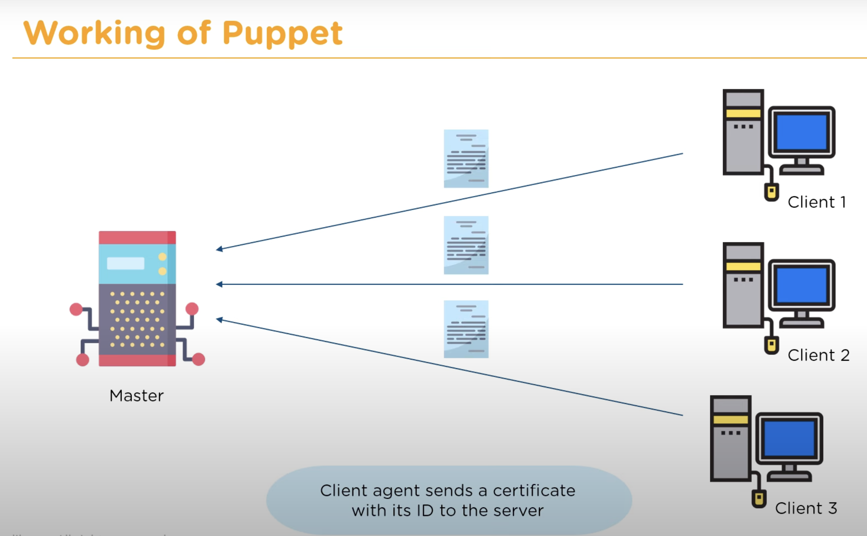

Slide 18
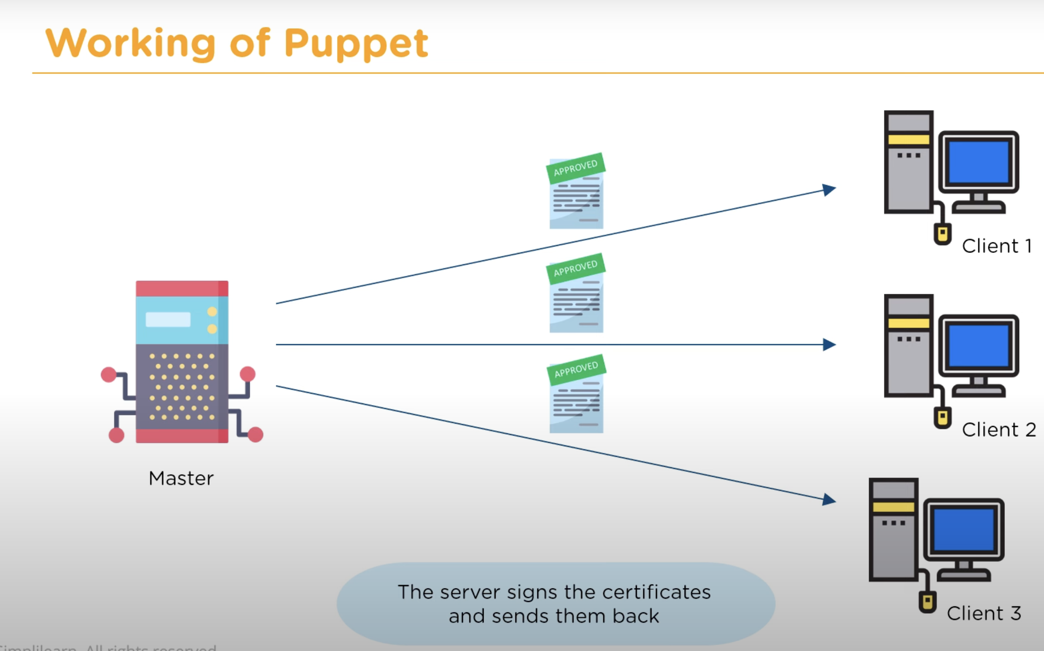

Slide 19
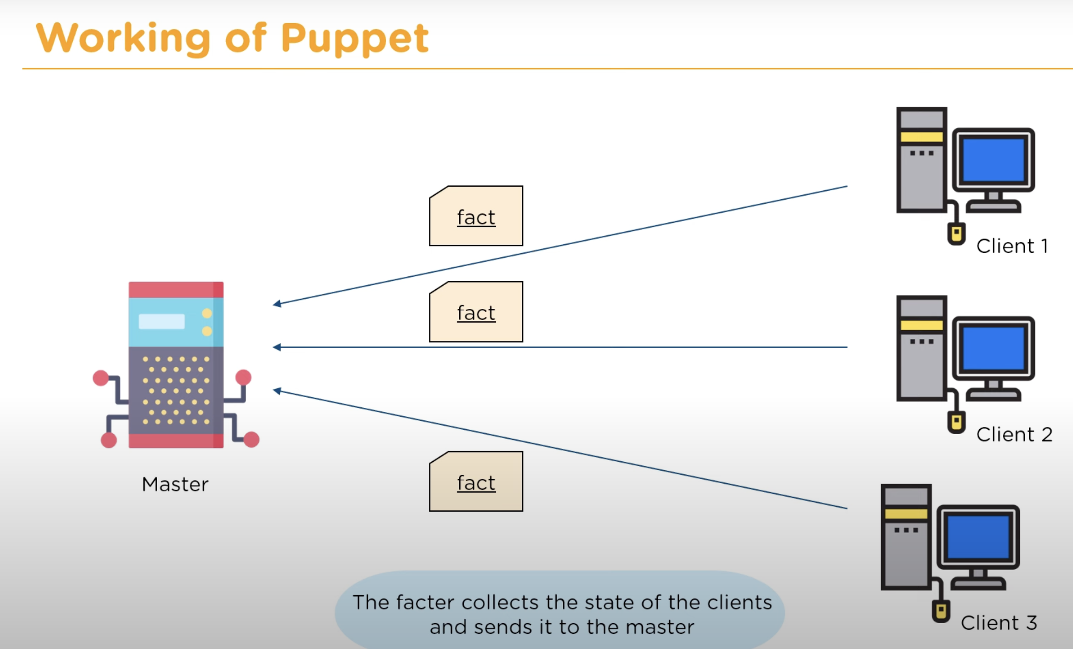

Slide 20
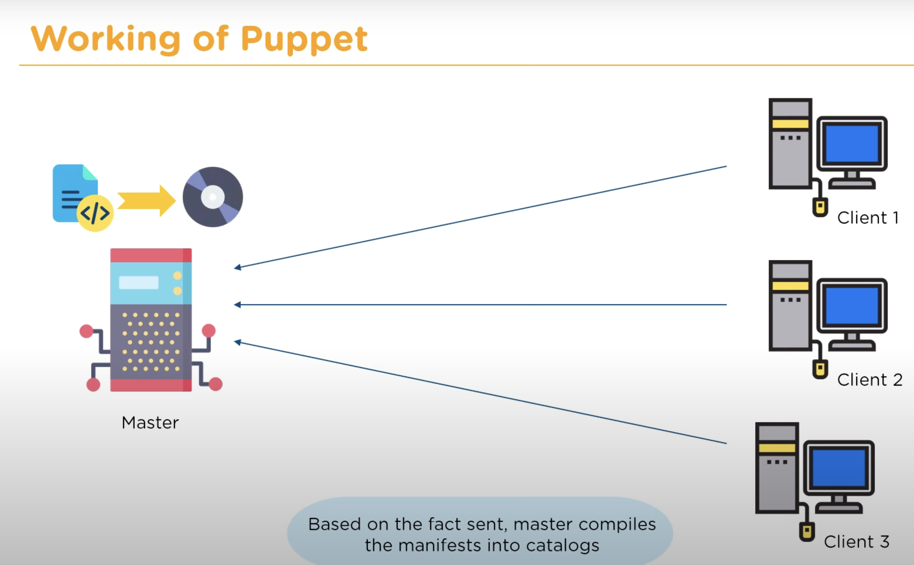

Slide 21
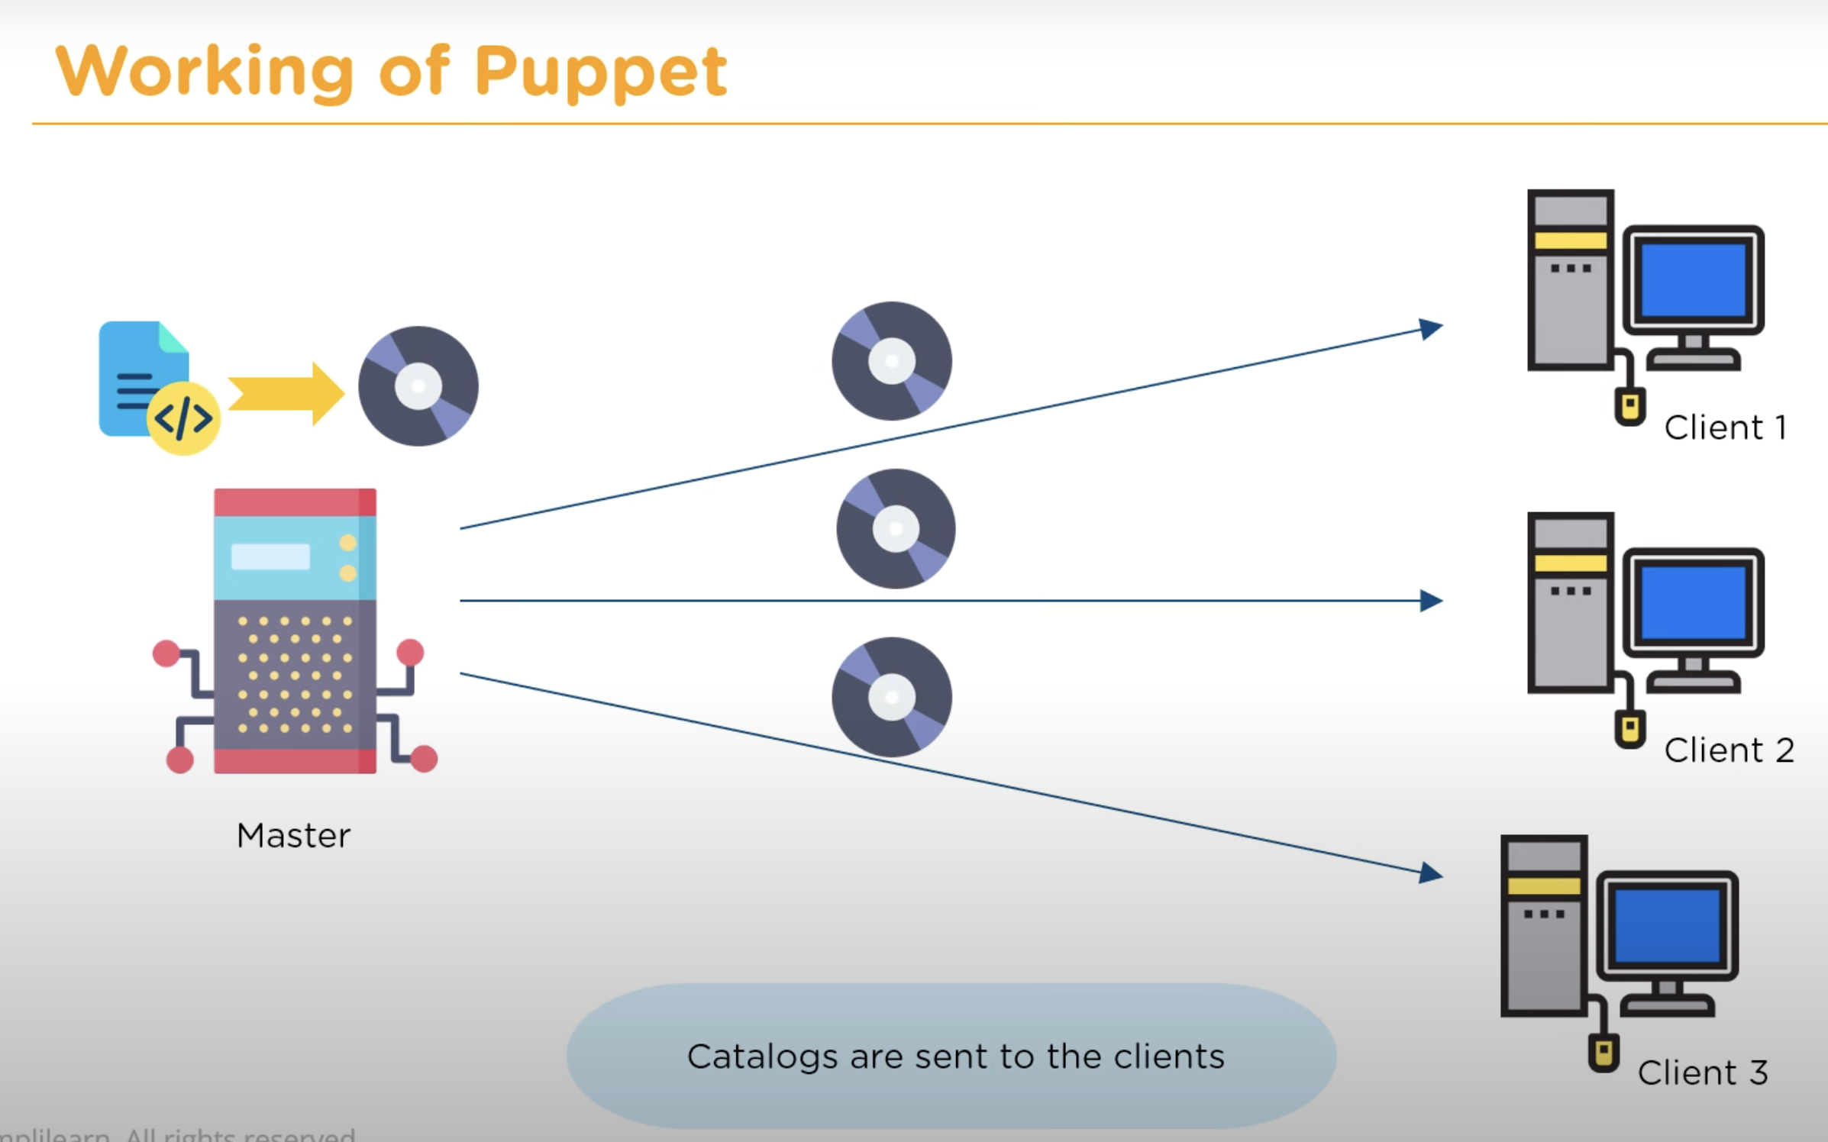

Slide 22
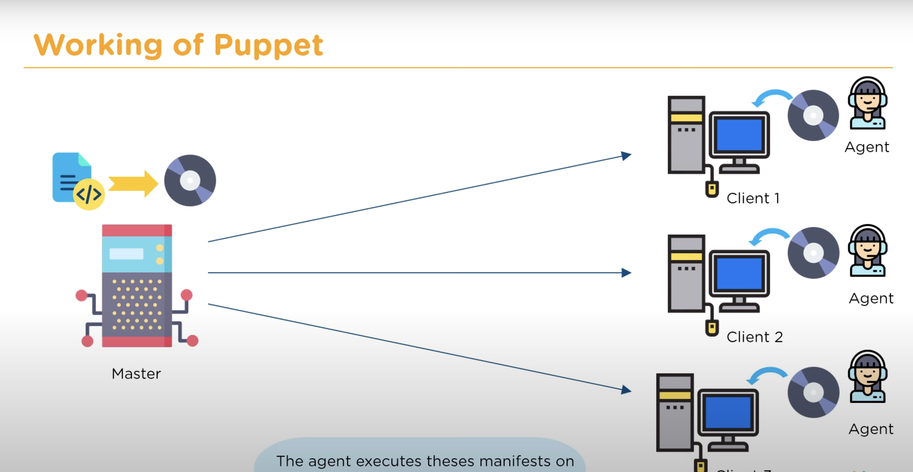

Slide 23
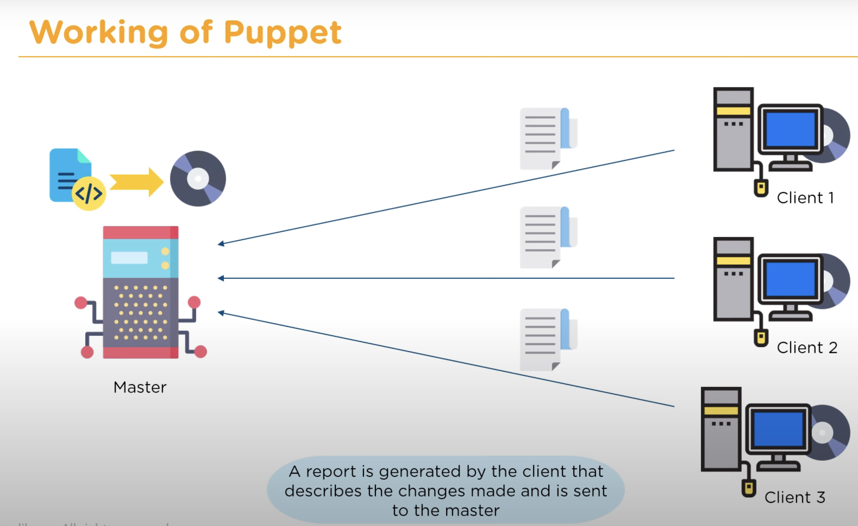

Slide 24
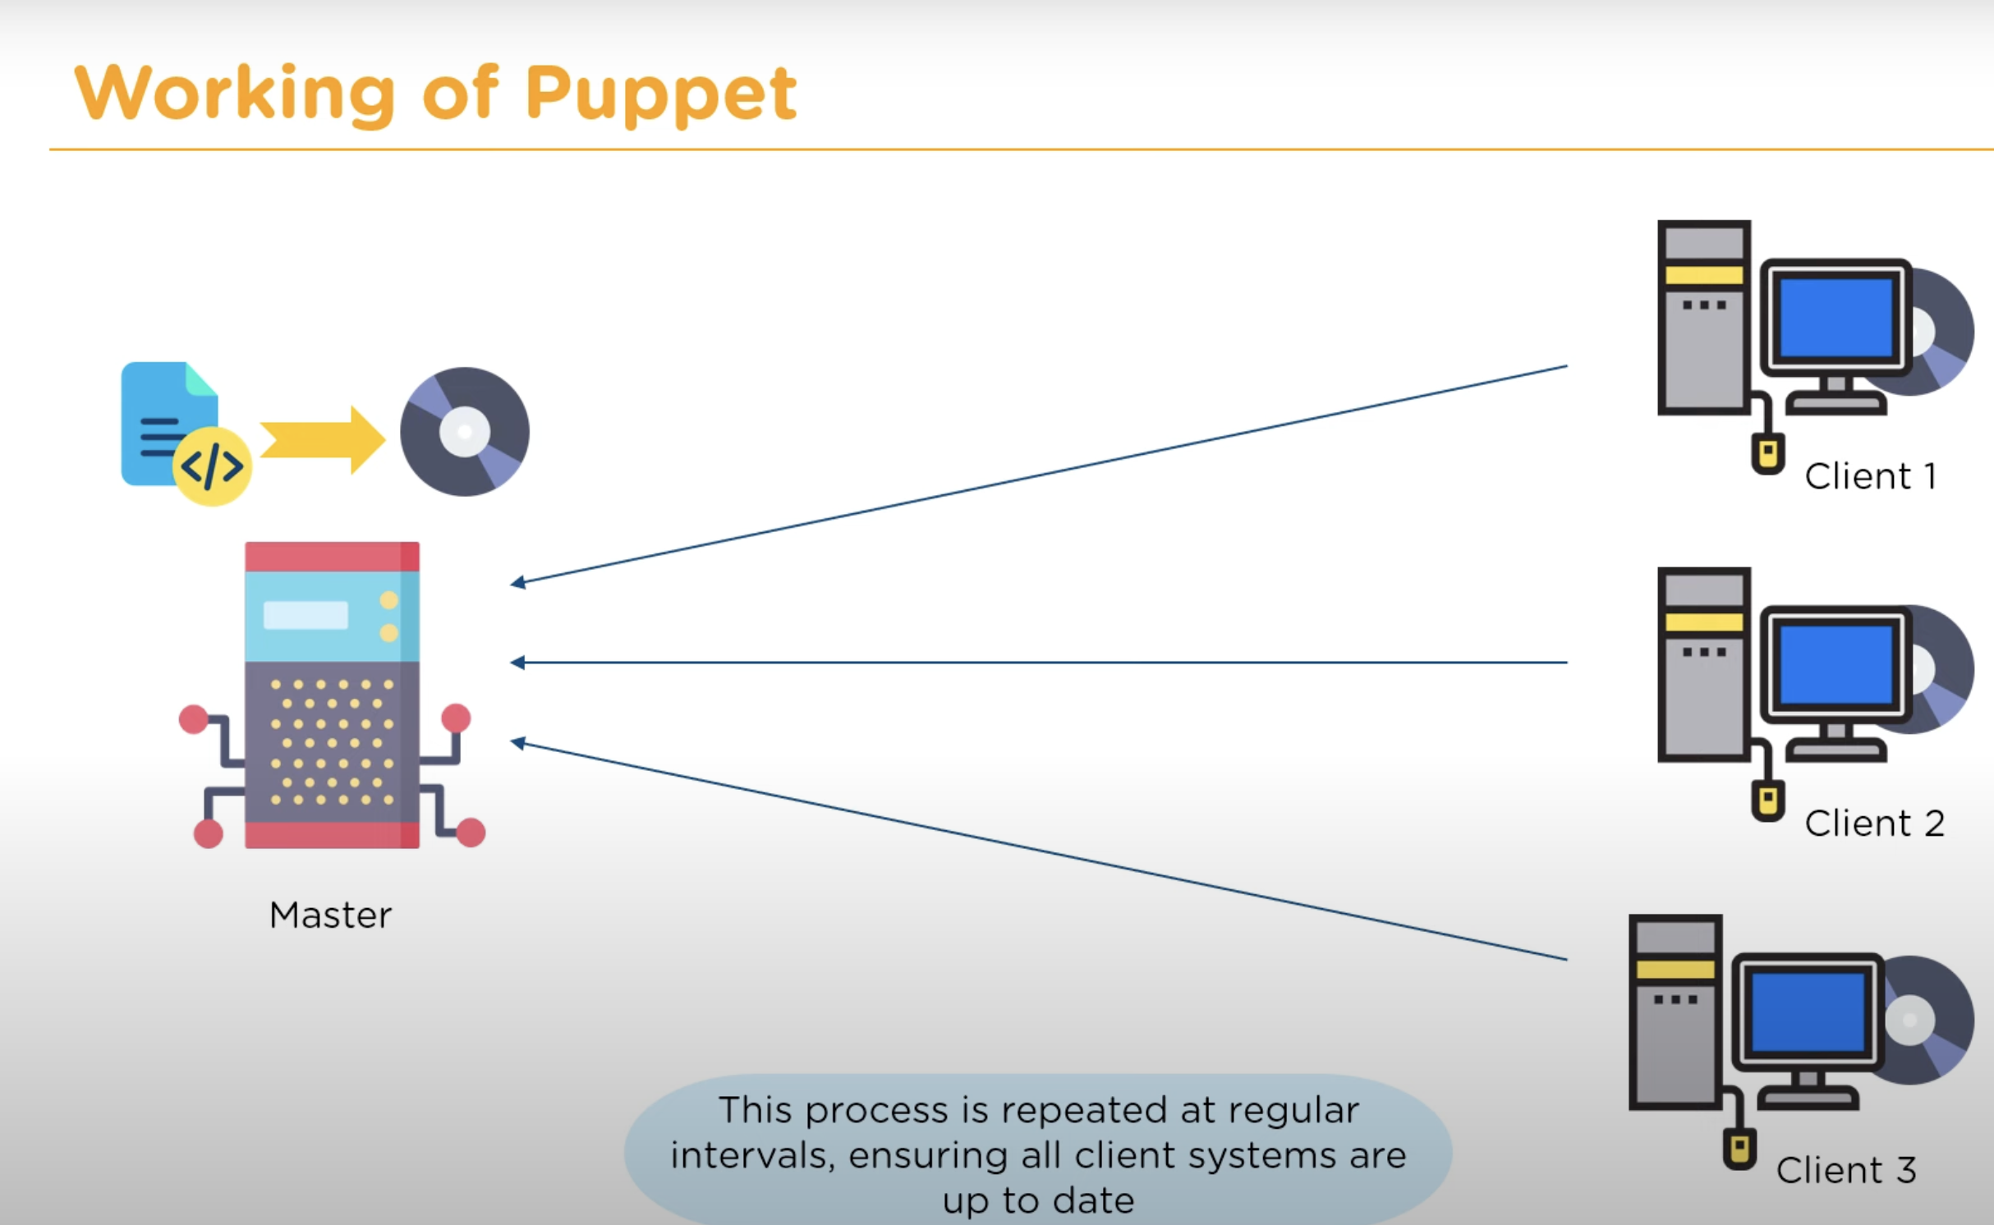

Slide 25
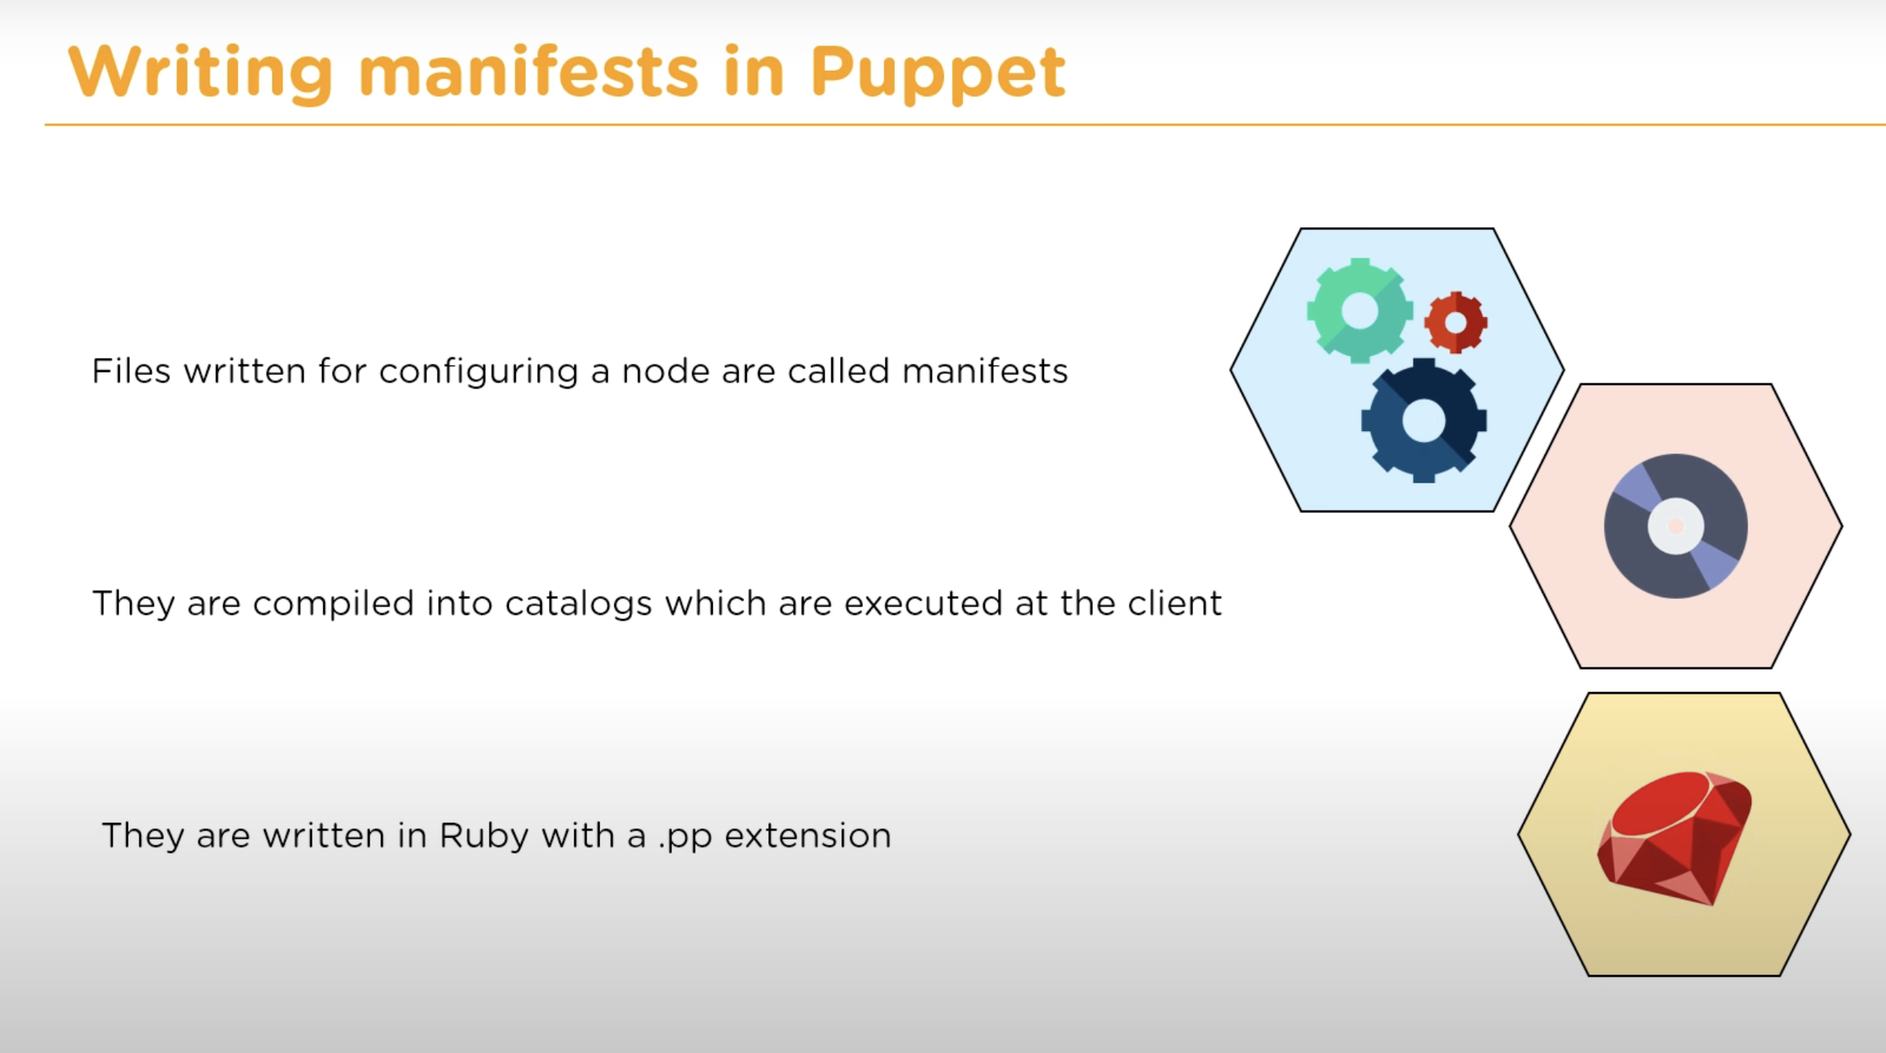

Slide 26


